Slide 1
Asymptotic Analysis
Lecture 3

Slide 2
Cont….
The complexity of an algorithm describes the efficiency of the algorithm in terms of the amount of the memory required to process the data and the processing time.
Complexity of an algorithm is analyzed in two
perspectives: Time and Space.

Slide 3
Cont…
Time Complexity
It’s a function describing the amount of time required to run an algorithm in terms of the size of the input. "Time" can mean the number of memory accesses performed, the number of comparisons between integers, the number of times some inner loop is executed, or some other natural unit related to the amount of real time the algorithm will take.

Slide 4
Cont…
Space Complexity
It’s a function describing the amount of memory an algorithm takes in terms of the size of input to the algorithm. We often speak of "extra" memory needed, not counting the memory needed to store the input itself. Again, we use natural (but fixed-length) units to measure this.

Slide 5
Asymptotic Notations
Execution time of an algorithm depends on the instruction set, processor speed, disk I/O speed, etc. Hence, we estimate the efficiency of an algorithm asymptotically.
Time function of an algorithm is represented by T(n), where n is the input size.
Different types of asymptotic notations are used to represent the complexity of an algorithm. Following asymptotic notations are used to calculate the running time complexity of an algorithm.
O − Big Oh
Ω − Big omega
θ − Big theta

Slide 6
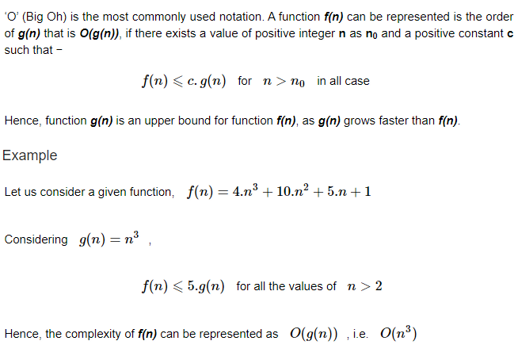
O: Asymptotic Upper Bound

Slide 7
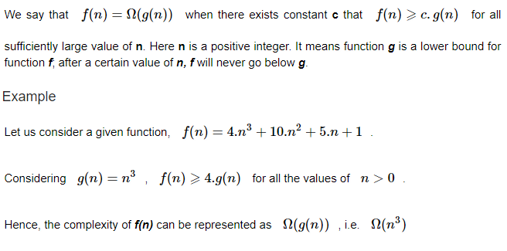
Ω: Asymptotic Lower Bound

Slide 8
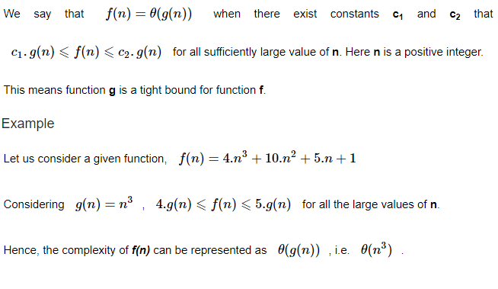
θ: Asymptotic Tight Bound

Slide 9
Analysis
1) O(1): Time complexity of a function (or set of statements) is considered as O(1) if it doesn’t contain loop, recursion and call to any other non-constant time function.
Set of non-recursive and non-loop statements
For example swap() function has O(1) time complexity.

Slide 10
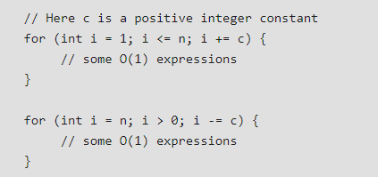
Cont…
2) O(n): Time Complexity of a loop is considered as O(n) if the loop variables is incremented / decremented by a constant amount. For example following functions have O(n) time complexity.

Slide 11
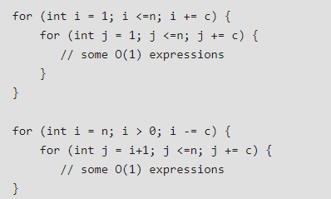
Cont…
3) O(n^{c}): Time complexity of nested loops is equal to the number of times the innermost statement is executed. For example the following sample loops have O(n²) time complexity.

Slide 12
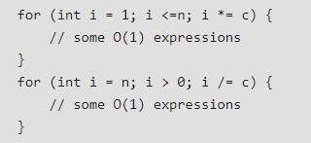
Cont…
O(Logn) Time Complexity of a loop is considered as O(Logn) if the loop variables is divided / multiplied by a constant amount.

Slide 13
Summations – Review

Slide 14
Review on Summations
Why do we need summation formulas?
Recall insertion sort

Slide 15
Review on Summations
Constant Series: For integers a and b, a ≤ b,
Linear Series (Arithmetic Series): For n ≥ 0,
Quadratic Series: For n ≥ 0,

Slide 16
Review on Summations
Cubic Series: For n ≥ 0,
Geometric Series: For real x ≠ 1,
For |x| < 1,

